Slide 2
Table of contents
What is a high-impact sequence ?
ImageBind-LLM, why no?
VIDEOLLAMA2, why?
UNIMODAL+Attention-based fusion Approache
Domains: Weighting and Finetunig: manual or automatic

Slide 3
01
Define a highlight(peak)

Slide 4
High-Impact Criteria
Peaks = moments where humans pay attention.
Shorts / Reels algorithms don’t care about:
average quality
long explanations
smooth narration
They reward:
sudden change
emotion
surprise
energy
And all of those appear in signals as peaks.
A contiguous temporal interval whose fused multimodal representation—integrating visual dynamics, salient audio cues, and transcript-level semantics—demonstrates elevated contextual importance and significant temporal contrast with respect to neighboring segments(peaks).

Slide 5
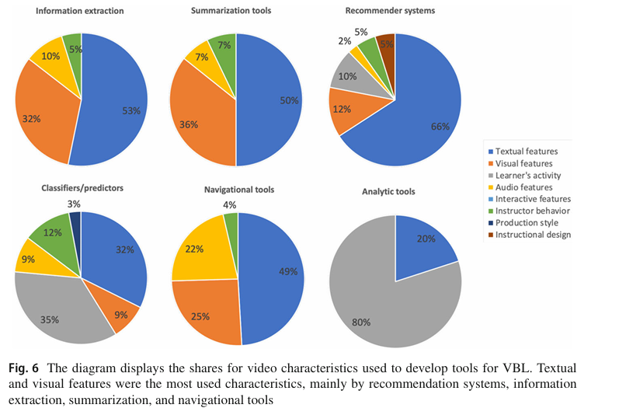
Features relevance in video treatment
txt>visual>audio

Slide 6
02
ImageBind LLM

Slide 7
“Enable an LLM to respond to multimodal inputs via instructions.”
ImageBind-LLM = ImageBind (frozen multimodal encoders) + a bind network + an LLM (LLaMA) for instruction following
Supports image, video, audio, text All mapped into a shared embedding space and the video as the anchor.
How ImageBind-LLM treats a video
Video → ImageBind video encoder
Audio → ImageBind audio encoder
Text → ImageBind text encoder
Embeddings are aligned, not temporally fused
LLM reasons after embedding alignment or embeddings are later treated outside of the model.
⇒ ImageBind-LLM is reasoning-centric, not temporal-centric.
Without prompts:
We only get independent clip embeddings
No native temporal contrast modeling
If We want highlights( our purpose), We must:
prompt the LLM
or manually score independent embeddings

Slide 8
Why ImageBind-LLM is NOT ideal
No native temporal self-attention
Each segment is embedded independently
Temporal contrast must be manually engineered: E(t) ⟂ E(t+1)
LLM is central: Designed for instruction following
Weak segment merging logic: No architectural support for:
sustained importance
contiguous highlights
We’d be rebuilding everything outside the model.

Slide 9
Why NOT ImageBind?
1. ImageBind is alignment-first, not temporal reasoning-first:
Learn a shared embedding space across 6 modalities Text, Audio,Image, Depth, Thermal, IMU (The video is missing too)
2. ImageBind has no native temporal token structure
ImageBind output : E∈RD (one embedding per clip) =>No notion of: E_t, E_{t+1}, E_{t-k:t+k}
ImageBind-LLM (l'extension) ajoute un LLM (LLaMA) et permet d'injecter des embeddings ImageBind.
3. ImageBind does no cross-modal attention: There is NO: QKV attention between modalities. Works with Contrastive alignment (CLIP-style)
4. No controllable modality weighting (text > audio > video)
5. ImageBind is not trained for “importance” or “impact”
ImageBind training signal: Cross-modal similarity+ Semantic alignment
It is NOT trained on: Highlight detection, Saliency, Emphasis, Audience reaction

Slide 10
03
VideoLLAMA2
what it is and why it best fits

Slide 11
“Understand videos as temporally evolving multimodal signals.”
What VideoLLaMA2 actually is
VideoLLaMA2 is a video-native multimodal transformer, designed for:
spatial-temporal modeling
audio-visual-text alignment
long video understanding
How VideoLLaMA2 treats a video
Video split into temporal segments
For each segment:
visual tokens
audio tokens
text tokens
Tokens are interleaved in time
Unified self-attention (QKV) across:
time
modality
This is the key architectural difference
What “high impact” means in VideoLLaMA2
A segment becomes salient when:
many tokens attend to it
it contrasts with neighbors
modalities reinforce each other
This emerges naturally from attention.
This is the key alignment:
VideoLLaMA2 already fuses video, audio, and text via QKV self-attention
No modality is discarded
Attention decides relevance dynamically.

Slide 12
Why VideoLLaMA2 is better
Native temporal modeling (critical)
Self-attention across time: E(t) ← attention(E(t−k … t+k))
This is exactly what highlight detection needs.
True cross-modal QKV attention Not alignment — fusion.
Text, audio, and video:
influence each other
dynamically change importance
Prompt-free, score-based use
We will:
extract embeddings
compute scores
merge segments
rank highlightS

Slide 13
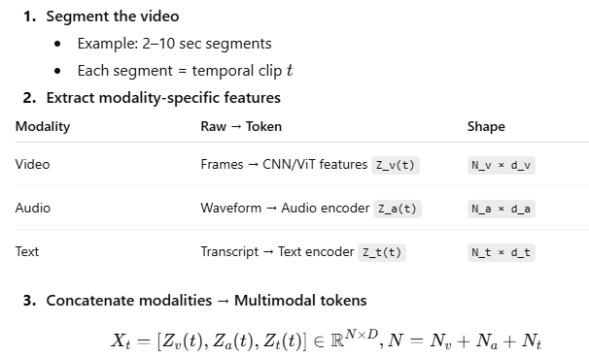
Preprocessing: Inputs preparation
Main Steps:
X_t is the input sequence of tokens fed into the model for segment t

Slide 14
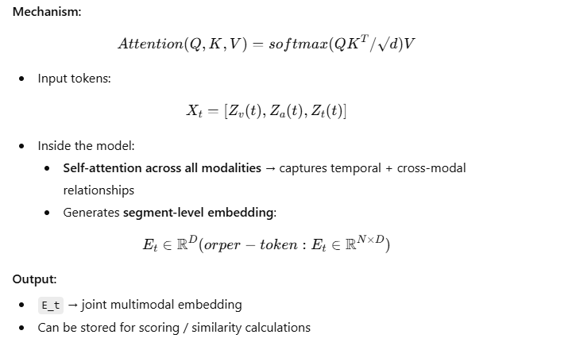
Cross-Modal Fusion & Joint Embedding Generation
Goal: Fuse video, audio, and text within each segment to get joint embeddings E_t

Slide 15
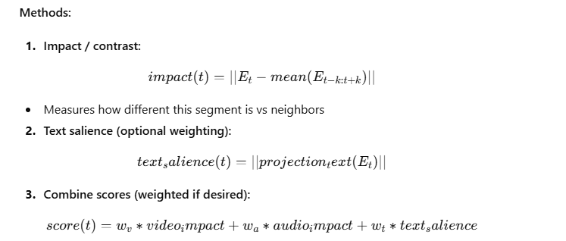
Postprocessing / Scoring
Goal: Identify high-impact segments based on multimodal embeddings
Here we may work on text salience if we assume text is more information-dense then the other modalities

Slide 16
When finetuning is useful?
1. Domain Adaptation
Your video/audio/text content is specific to a domain (medical, sports, finance, education).
Pretrained VideoLLaMA2 may not capture domain-specific semantics or jargon.
2. Custom Highlight Detection
If your definition of high-impact moments differs from general benchmarks.
Finetuning aligns embeddings and scoring to your notion of “impact.”
3. Multimodal Weighting Preferences
You want to prioritize text/audio/visual modalities differently (e.g., text > audio > video) (Depending on the domain).
Finetuning can emphasize certain modalities in joint embeddings.
….

Slide 17
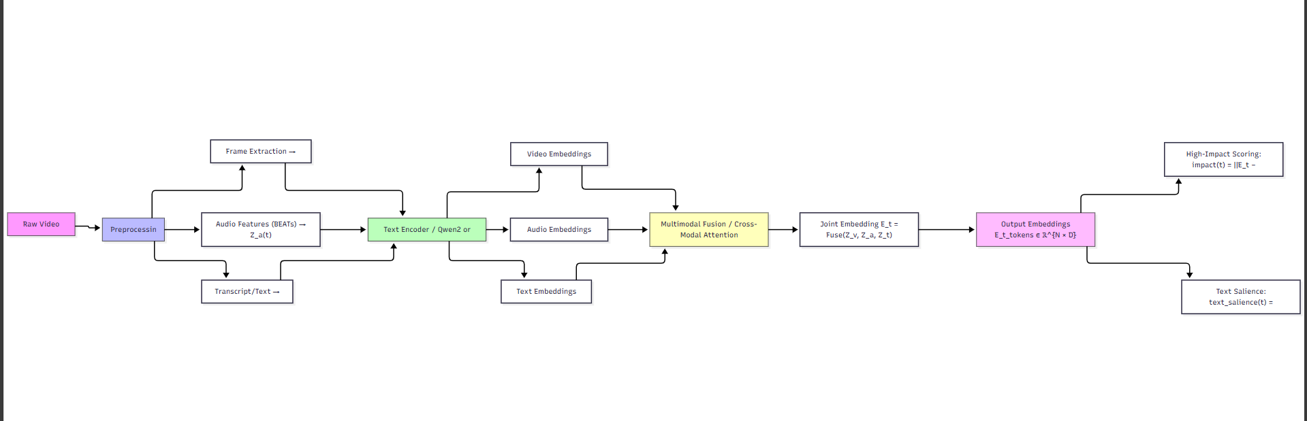
Pipeline
2406.07476
DAMO-NLP-SG/VideoLLaMA2: VideoLLaMA 2: Advancing Spatial-Temporal Modeling and Audio Understanding in Video-LLMs

Slide 18
model_init(...) → load model + processor
processor(images=..., audio=..., text=...) → prepare inputs
model(**inputs) → forward pass
Hook or manual extraction → get fused_embedding (per segment)
Modules / Attributs that we might use (if manual fusion or personnalised weighting
model.vision_encoder → features visuelles
model.audio_encoder → features audio (version AV)
model.projector / model.qformer → couches de fusion multimodale
processor → préparation des inputs
model(**inputs) → forward complet
from videollama2 import model_init
model, processor, tokenizer = model_init(
model_path="DAMO-NLP-SG/VideoLLaMA2.1-7B-16F”)
inputs = processor(
images=frames, # liste d'images RGB
audio=audio_waveform, # audio 16kHz
text=transcript, # brut (transcription)
return_tensors="pt"
).to(device)
with torch.no_grad(): outputs = model(**inputs)
with torch.no_grad(): outputs = model(**inputs)
Recuperer les embeddigns:
embeddings = {}
def hook_fn(module, input, output):
embeddings["fused"] = output.last_hidden_state.mean(dim=1)
handle = model.projector.register_forward_hook(hook_fn) # ou qformer / projector
_ = model(**inputs)
embedding_fusion = embeddings["fused"] # [1, dim]
handle.remove()
Si fusion manuelle:
visual_emb = model.vision_encoder(inputs.pixel_values)
audio_emb = model.audio_encoder(inputs.audio_values) text_emb = model.get_input_embeddings()(inputs.input_ids)
embedding_fusion = (visual_emb.last_hidden_state.mean(1) +
audio_emb.mean(1) +
text_emb.mean(1)) / 3

Slide 19
04
UNIMODAL+Attention-based fusion Approache

Slide 20
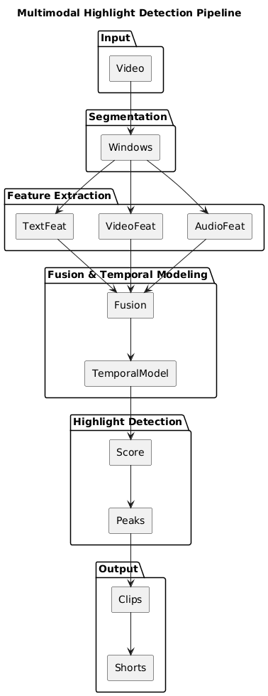

Slide 21
STEP 1 — Input
Long-form video
Conference
Podcast
Live stream
Input: MP4 (video + audio)
STEP 2 — Temporal Segmentation
Split the video into short, fixed windows:
0.5s – 2s (recommended: 1s)
Each window = one candidate moment.
V = {w1, w2, w3, ..., wT}
This is what makes peak detection possible.
STEP 3 — Modality-Specific Feature Extraction
🎧 Audio (emotion + energy)
Goal: detect excitement, laughter, tension
Tools
librosa / torchaudio
optional pretrained Speech Emotion Recognition(SER) model
Features (per window):
RMS energy
Pitch
Spectral flux
Emotion probability (happy / excited)
Output : vecteur : A_t = audio_features(window_t)
Exp : A_t = [0.82, 210, 0.65, 0.91]

Slide 22
🎥 Video (motion + facial emotion)
Goal: detect visual reactions and motion bursts
Tools
OpenCV / PyTorch
optional facial emotion model
Features (per window):
Motion intensity (frame difference / optical flow)
Face emotion intensity
Scene change score
V_t = visual_features(window_t)
📝 Text (semantic emotion, NOT summary)
Goal: detect emotionally charged speech
Tools
Whisper (transcription)
BERT / emotion classifier
Features (per window):
Sentiment score
Emotion probability
Keyword emphasis
T_t = text_features(window_t)

Slide 23
STEP 4 — Multimodal Fusion (THE BRAIN)
Concatenate all modality features:
X_t = [A_t ; V_t ; T_t]
Now feed the sequence into a temporal model:
Recommended models:
BiLSTM (simple, effective)
Temporal Transformer (best quality)
This model learns:
cross-modal interactions
temporal contrast
peak patterns
STEP 5 — Highlight Probability (KEY OUTPUT)
The fusion model outputs:
P_t = probability that window_t is a highlight
This is NOT semantic similarity. This is impact probability.
STEP 6 — Peak Detection
Now detect local maxima in P_t:
✔ High value ✔ Higher than neighbors ✔ Sudden increase
These are your true highlights.
Highlights = peaks(P_t)

Slide 24
STEP 7 — Clip Selection & Assembly
Select top-K peaks
Extend windows (e.g. ±3–5 seconds)
Merge overlapping clips
Generate captions (optional)
STEP 8 — Output
Final Output:
- 15–60s Short video
- Captions
- Thumbnail

Slide 25
05
Temporal transformer

Slide 26
0️. Where we are
At each time step t (e.g. 1 second):
A_t = audio features (energy, pitch, emotion)
V_t = visual features (motion, facial emotion)
T_t = text features (sentiment, emotion)
→ You concatenate X_t = [A_t ; V_t ; T_t] → one vector
So your full input is a sequence: X = [X_1, X_2, X_3, ..., X_T] (Shape: (T, D) )
1️ What fusion REALLY means (important)
Fusion means:
“Learn how features from different modalities interact over time to predict highlights.”
This learning happens through weights inside the model.

Slide 27
2️. What the model does to X_t
STEP 1 — Linear projection
Each X_t goes through a linear layer:
H_t = W * X_t + b
This:
mixes audio + video + text
puts them into a shared latent space
📌 This is already fusion:
If motion + loud audio often mean highlights,
the weights will learn that combination.
STEP 2 — Self-attention
At time t, the model asks:
“Which OTHER moments in the video help me decide if THIS moment is a highlight?”
Examples:
Sudden motion AFTER silence
Emotional sentence followed by laughter
Reaction shot after a key phrase
The transformer links moments together.
It outputs:
the same number of time steps
but each step now contains context-aware information
Before attention: t3 = only what happened at second 3
After attention: t3 = what happened at second 3 + related moments

Slide 28
2️. What the model does to X_t
STEP 3 — Cross-modal interaction (where fusion actually happens)
Cross-modal interactions are learned implicitly through linear projections and temporal self-attention.
Attention learns patterns like:
High audio energy + fast motion = strong signal
Emotional words + calm visuals = medium signal
Motion spike without emotion = weak signal
These interactions are learned via:
linear projections
attention weights
STEP 4 — Feed-forward network (decision refinement)
After attention: Y_t = FFN(Z_t)
FFN is a small neural network applied to each time step.
It refines the attended features, making highlights clearer and boring moments smaller.
sharpens peaks
suppresses noise
increases contrast between boring vs exciting
STEP 5 — Highlight probability
Final layer: p_t = sigmoid(W_out * Y_t)
Output: p_t ∈ [0, 1]
This is the highlight probability for second t.

Slide 29
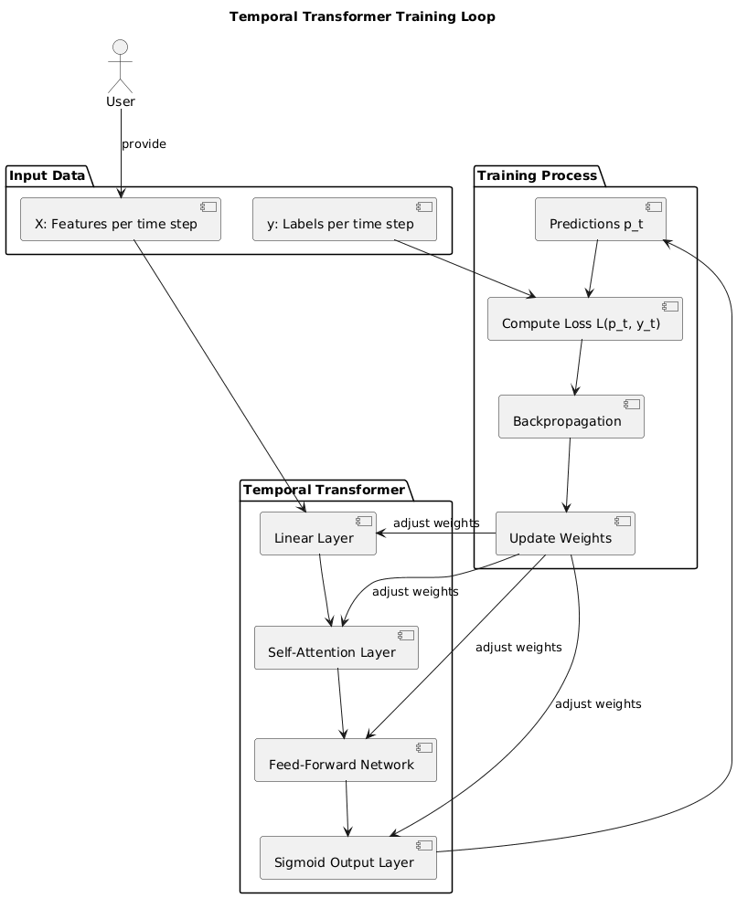
Temporal transformer training loop :

Slide 30
06
Labels for training

Slide 31
Time (s) | Inside highlight? | Label
129 | no | 0
130 | yes | 1
131 | yes | 1
132 | yes | 1
… | … | …
145 | yes | 1
146 | no | 0
METHOD 1 — Using highlight timestamps (BEST & SIMPLEST)
You label segments, not seconds.(manually)
Example (human or dataset):
Video 1:
Highlight from 02:10 → 02:25
Highlight from 07:40 → 07:55
That’s it. Two timestamps. Not 900 seconds.
If you use 1-second windows:
One highlight → dozens of labeled windows automatically
You can label 5–10 highlights per video
→ That’s enough

Slide 32
METHOD 2 — Weak labels (NO MANUAL LABELING)
Step 1 — Use signals you already extract
You already compute:
audio energy
laughter probability
motion intensity
emotion probability
So you create rules (not perfect, but OK):
Example:
If audio_energy > 90th percentile
AND (motion > threshold OR emotion > threshold)
→ y_t = 1 Else → y_t = 0
BUT: Highlights are NOT always peaks
Some real highlights are:
❌ not loud ❌ not fast ❌ not emotional
Examples:
dramatic silence before a reveal
important dialogue line
plot twist with low motion
subtle facial expression
Your method will miss these completely.

Slide 33
07
Public Datasets for Highlight Detection

Slide 34
1. QVHighlights (Query‑based Video Highlights)
Large dataset with over 10,000 YouTube videos.
Each video includes:
Natural language queries
Relevant temporal moments
Saliency scores on clips that can be turned into highlight labels.
Good for learning general highlight detection rather than specific categories.
Why it’s useful
Directly annotated for highlight/moment detection
Works across many genres (news, travel, lifestyle)
2. TVSum
Classic benchmark in video summarization and highlight detection.
50 videos, each labeled with frame/shot importance scores from human annotators.
You can convert these scores to binary highlight labels for your task.
Pros
Widely used in academic research
Strong for evaluating highlight detection models
Cons
Small dataset (only 50 videos)

Slide 35
3. Mr. HiSum
A very large dataset with 31,892 videos and crowd‑aggregated highlight labels.
Unlike small summarization sets, this one was designed specifically for highlight detection & summarization.
Why this is great
Huge scale → better for training neural models
Reliable labels thanks to many raters
4. TimeIT (Multi‑task video dataset)
A combined dataset covering multiple tasks, including video highlight detection with nearly 7,000 annotated moments.
Useful if you need:
More videos with timestamped events
Variety beyond the standard TVSum/QVHighlights scope

Slide 36
03
Signal Pre-Processing

Slide 37
Transforming Raw MP4 into "AI-Ready" Semantic Tokens
The "Feature Extraction" Pipeline
To feed our Unified Multimodal Backbone, we first deconstruct the raw signal into three specialized data streams:
Acoustic Energy Analysis (Audio)
Tool: librosa / VGGish
Action: Extracting RMS Energy and Spectrograms.
Goal: Identifying "Excitement Peaks" (Laughter, shouting, applause) that indicate a potential highlight before the model even reads the text.
NLP & Transcription (Text)
Tool: OpenAI Whisper
Action: Transforming speech into Word-Level Timestamps.
Goal: Converting unstructured audio into Semantic Tokens. This allows the V0 backbone to "read" the video’s narrative.
Frame & Spatial Analysis (Video)
Tool: OpenCV / PyTorch
Action: Sampling Keyframes and generating Visual Patches.
Goal: Reducing the MP4 from millions of pixels to a series of "Visual Concepts" (Faces, objects, movement) that the Transformer can process.

Slide 38
04
Best multimodal models

Slide 39
CLIP
CLIP is an AI model that learns the connection between images and their descriptions(text). It can understand what's in a picture by reading about it, and describe pictures by understanding their content—all without ever being explicitly told what to look for.
Key Capabilities:
Zero-shot image classification (identify objects it was never specifically trained on)
Image search by natural language ("find pictures of a sunset over mountains")
Cross-modal understanding (link visual concepts with textual descriptions)
Why It's Revolutionary:
Breaks the traditional training paradigm: Instead of training on labeled datasets ("this is a cat"), it learns from natural language descriptions ("a fluffy cat sleeping in sunlight")
Generalizes remarkably well to new categories without retraining
Opens the door for more human-like AI understanding

Slide 40

Example
CLIP makes the connection:
- Golden colors = "sunset"
- Water = "ocean waves"
- Overall mood = "beautiful"
→ CLIP embeds images and text into the same semantic space, allowing direct comparison and understanding across modalities.
Text: "Beautiful sunset over ocean waves"
→ CLIP can look at any picture and find the perfect words to describe it, or read any description and find pictures that match.
For our project, this means automatically finding when what's being SAID matches what's being SHOWN—the key to identifying truly impactful moments.

Slide 41
Why This Matters in our project ?
Your video has someone saying "Look at this incredible chart!" but the chart appears 3 seconds later.
Without CLIP: You only know there's a chart mentioned at 1:30, but not when it actually shows up.
With CLIP: It scans the video and finds the exact moment (1:33) when the chart appears on screen, matching the spoken words with the visual.
The most impactful moments happen when:
What's said (audio/subtitles)
What's shown (video/images) ...align perfectly.
→ CLIP finds those perfect alignment moments automatically.

Slide 42
ImageBind
Developed by Meta (Facebook) in 2023, ImageBind is an AI model that connects six different "senses" into one shared understanding. It can link what you see, hear, feel, and measure—creating a unified understanding of the world just like humans do.
It Binds 6 modalities into one AI brain:
Images (what you see), Text (what you read), Audio (what you hear), Depth (3D space), Thermal (heat), IMU (motion sensors)
Why It's Revolutionary:
First model to bind this many modalities without paired training data
Emergent zero-shot capabilities: Learns connections it was never explicitly taught
Opens door to truly embodied AI that understands the world like humans

Slide 43
ImageBind's Magic Role: ImageBind translates audio into MEANING:
1. Audio Understanding
audio_input = "laughter_sound.wav"
# Traditional approach (without ImageBind):
result = librosa.analyze(audio_input)
# Returns: loudness=0.8, pitch=200Hz
# WITH ImageBind:
result = imagebind.understand(audio_input)
# Returns: emotion="humor", intensity=0.9, confidence=0.95

Slide 44
2. Connecting Sound to Text
Audio at 2:15: 🔊 [Laughter sound]
Text at 2:16: "That was hilarious!"
WITHOUT ImageBind:
- Two separate events: "sound at 2:15" + "text at 2:16"
- How to connect them?
WITH ImageBind:
- Audio → "humor" meaning
- Text → "hilarious" = humor meaning
→ SAME MEANING = SAME HIGHLIGHT MOMENT!

Slide 45

Key Uses of ImageBind in Your Project
1: Emotional Scoring
Before ImageBind:
Flaw:
A whispered secret (quiet but exciting) gets low score!
A microphone thump (loud but meaningless) gets high score!
WITH ImageBind : Instead of just loudness, get EMOTION
→ Whispered secret (high emotion) scores WELL!
Loud thump (no emotion) scores POORLY!

Slide 46
2: Cross-Checking
The Problem: Sometimes text and audio disagree, creating confusing moments:
Example 1: Sarcasm Detection
AUDIO (sarcastic tone): [Flat, monotone voice]
TEXT: "Wow, that's just amazing."
WITHOUT ImageBind: "Positive text + Neutral audio = Good clip?"
WITH ImageBind: ImageBind detects SARCASTIC tone from audio
Example 2: Fake Excitement
Audio: [Forced laughter, unnatural] ← ImageBind: "FAKE/STAGED"
Text: "HAHA that's hilarious!" ← GPT: "HUMOR"
RESULT: "Audio says FAKE, text says REAL → CONFLICT → SKIP"

Slide 47
3: Finding Hidden Gems
Sometimes the audio tells the real story:
Text: "Let me show you something" ← Neutral
Audio: [Gasps, whispers, tense music] ← ImageBind: "SUSPENSE!"
RESULT: Hidden exciting moment found!

Slide 48
LLaVA
LLaVA is an open-source AI that can see images, understand what's in them, and have conversations about visual content.Works with 2 Modalities: Images +TEXT
Developed by Microsoft & University of Wisconsin-Madison (open source!)
Combines a vision encoder (CLIP-like) with a large language model (Vicuna/Llama)
Core capability: You can show it a picture and ask questions about it
Key Features
Multimodal Instruction-following Data: The model uses instruction-following textual data generated from ChatGPT/GPT-4 to train LLaVA. The data contains questions regarding visual content and responses in the form of conversations, descriptions, and complex reasoning.
For our Project: LLaVA can answer your questions about video frames: "Is this moment exciting?", "Why is the audience reacting?", "What's the emotional tone here?"...

Slide 49
Language Decoder: LLaVA connects Vicuna as the language decoder with CLIP for model fine-tuning on the instruction-following dataset.
For our Project: This is why LLaVA is so good at describing what it sees—it uses the best visual understander (CLIP) with a smart language brain (Vicuna).
Trainable Project Matrix: The model implements a trainable projection matrix to map the visual representations onto the language embedding space.
This is the translator between picture-language and word-language (It translates what CLIP sees into words Vicuna can understand.)

Slide 50
Why It's Perfect for Our Project:
While CLIP just matches images with text, LLaVA understands context and relationships in visual scenes.
WHAT LLaVA SEES vs OTHERS:
[PHOTO: Speaker pointing at chart, audience laughing]
CLIP: "person, chart, people" → Just objects
ImageBind: "laughter sound" → Just audio
LLaVA: "The speaker made a joke about the data and everyone finds it funny!"
→ UNDERSTANDS THE CONTEXT AND STORY

Slide 51
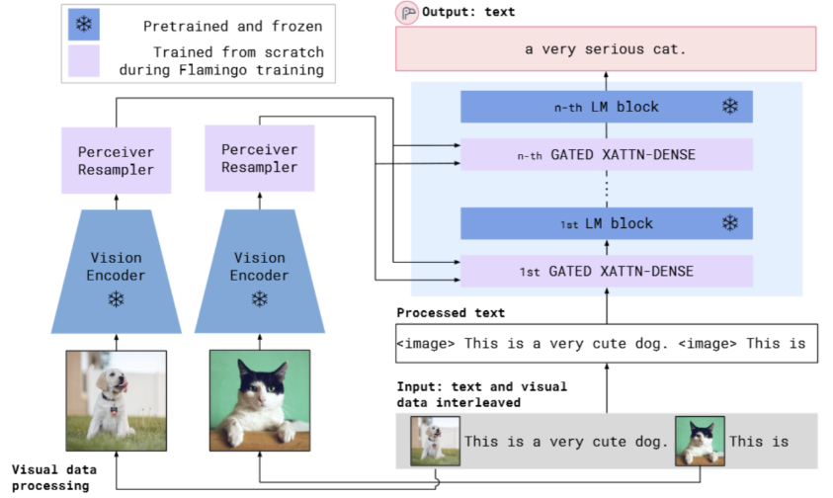
Flamingo (DeepMind)
Flamingo is a vision-language model designed to reason over interleaved images, videos, and text within a single sequence.
Architecture and Core Innovation :
Based on a Transformer architecture,
Its key innovation is the gated cross-attention
mechanism, which acts as an adapter to fuse
pre-trained visual features from a vision encoder
(like CLIP) into a frozen, powerful LLM. This
design is highly parameter-efficient
and enables its standout capability.
Modalities: Text, Images, and Videos (Interleaved Input → Text Output).

Slide 52
Key Capabilities:
In-Context Few-Shot Learning: Can rapidly adapt to new visual tasks using only a few examples in its prompt, without requiring any fine-tuning.
Long-Context Processing: Maintains narrative coherence and context when processing long, interleaved sequences of visual and textual inputs.
Why This Matters in our project?
The Problem: Coding a "high-impact" detector is hard because "impact" varies (humor vs. tension).
The Advantage: We can give the model 3 examples of "viral clips," and it learns to find similar patterns without a massive dataset.
Limitations: High computational cost for inference

Slide 53
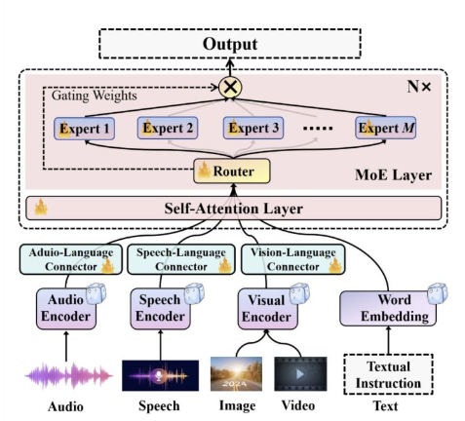
GPT-4o (OpenAI)
A natively end-to-end multimodal model that unifies text, vision, and audio processing into a single neural network, enabling real-time, conversational interaction.
Architecture and Core Innovation :
A true unified Transformer trained on text,
images, and audio simultaneously from
the ground up. This allows for deep,
low-level fusion of modalities,
unlike systems that use separate models
together.
Modalities : Text, Image, Audio – unified for real-time processing.

Slide 54
Key Capabilities:
Low-latency multimodal responses: Responds in ~232ms, making it ideal for live video/audio analysis.
Affective Reasoning: Detects nuances in emotion, tone of voice, and background noise to provide context-aware responses.
Why This Matters in our project?
The Problem: Text-only analysis misses the "vibe" or "energy" of a video.
The Advantage: It solves the Multimodal Fusion challenge by detecting laughter or shouting directly from the audio signal.
Limitations: Closed-source and potential high API costs.

Slide 55
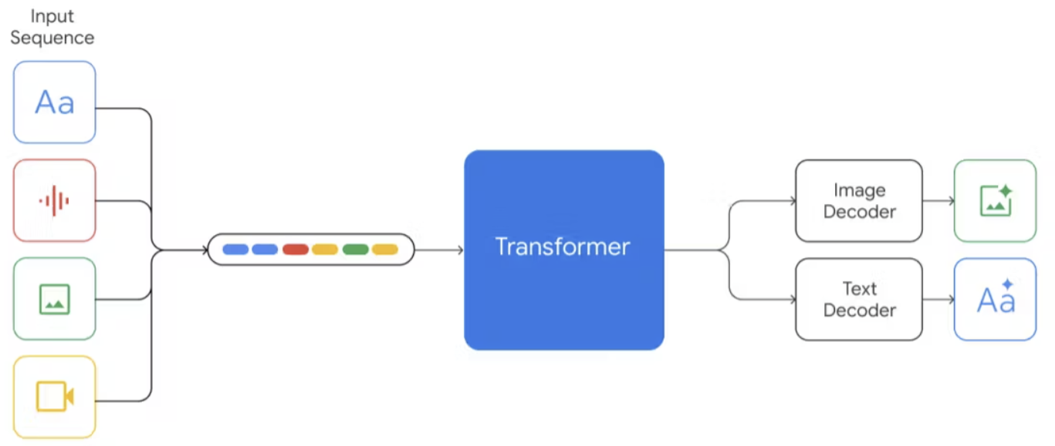
Gemini (Google DeepMind)
A highly efficient multimodal Transformer built for deep reasoning across massive datasets.
Architecture and Core Innovation :
A multimodal Transformer trained with a
novel mixture-of-experts (MoE) approach
on a massive, diverse dataset.
By routing tasks through specialized neural
"experts" dedicated to text and video,
the system achieves unprecedented
efficiency across different data types.
It is specifically optimized for complex reasoning tasks.
Modalities : Text, Code, Image, Audio, Video.

Slide 56
Key Capabilities:
Massive Context Window: has long context windows, making it capable of processing long-form videos, text, code, and words.
Native Cross-Modal Reasoning: Seamlessly correlates events across modalities, such as finding a visual scene based on a specific audio keyword.
Post-training: The model uses supervised fine-tuning and reinforcement learning with human feedback (RLHF) to improve response quality and safety.
Why This Matters in our project?
The Problem: Extracting precise, reliable timestamps from raw 3-hour streams is our main technical challenge.
The Advantage: Gemini's "memory" allows it to compare every segment of a long video to pick only the best ones.
Limitations: Closed source :proprietary model and "Black box" architecture

Slide 57
Thanks for your attention!

